Slide 1
Use of real time and spatial data for Aedes aegypti monitoring to improve vector control response in Jamaica.
K. Parchment¹, J. Magaritis¹, Quang Truong¹, Sherine Huntley Jones², Dr. Simone Spence², Allison Belemvire³
¹Abt Associates, Rockville, MD 20852, USA.
²Ministry of Health and Wellness, Kingston, Jamaica
³United States, Agency for International Development, Takoma Park, Maryland.

Slide 2
Overview: Zika Airs Project (ZAP)
USAID launched and funded the Zika AIRS Project in Latin America and Caribbean in 2016 in response to the Zika outbreak.
Aim: To reduce and control mosquito populations responsible for transmitting arboviruses such as Zika and Dengue.
Vector Control Activities/Strategies: Eliminating breeding sites (source reduction), larviciding (Bacillus thuringiensis israelensis) and educational messages to local residents.

Slide 3
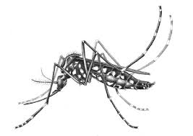
Introduction
Vector Control response is any method used to limit or prevent transmission of disease caused by an animal.
The ability to track vector populations using current technology is critical to drive decisions and strategies to reduce the vector-human contact.
Use of consistent surveillance tools and effective monitoring and evaluation will improve the likelihood of preventing vector-borne disease outbreaks (Eisen at al, 2009).
Using electronic data collection system allows decision makers to receive faster and higher quality data.
Spatial analysis is a useful way to describe impact on traditional entomological indicators used to monitor mosquito populations after vector control measure are implemented.

Slide 4



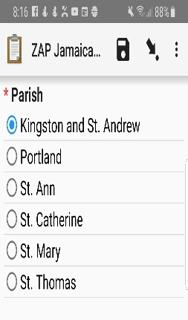
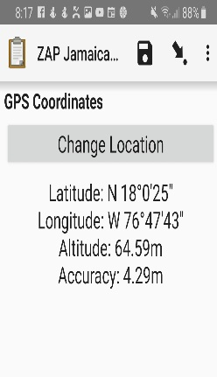
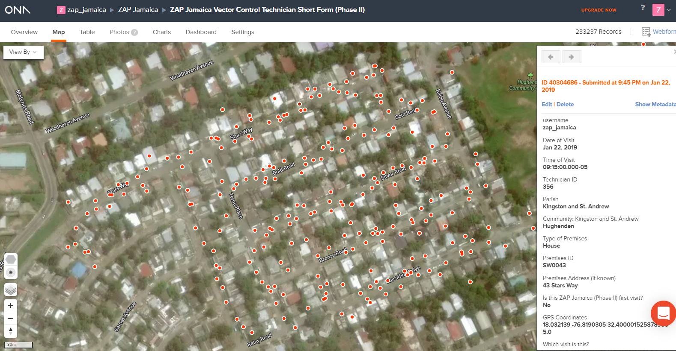


Implementing Real Time Data Collection System Tools
Real Time
Data Collection System
Form Builder XlsForm/ Web Form Builder
Data Manager www.ona.io
Data Collector
ODK Collect
Data Analytics/ Visualization
Benefits of implementing real time data collection system
Faster
Accuracy
Lower cost
Data integrity
Geodatabases
Validations rules
Ecological solution
Notes:
This is the ZAP Data Flow. Currently ZAP uses Form Builder or XLS forms via XLS coding to develop forms for data input. Data collection is done by the free app ODK Collect then the data is sent to a server and stored on our free data manager ONA,
Afterwards that data is integrated into out analytical software called Tableau desktop.

Slide 5
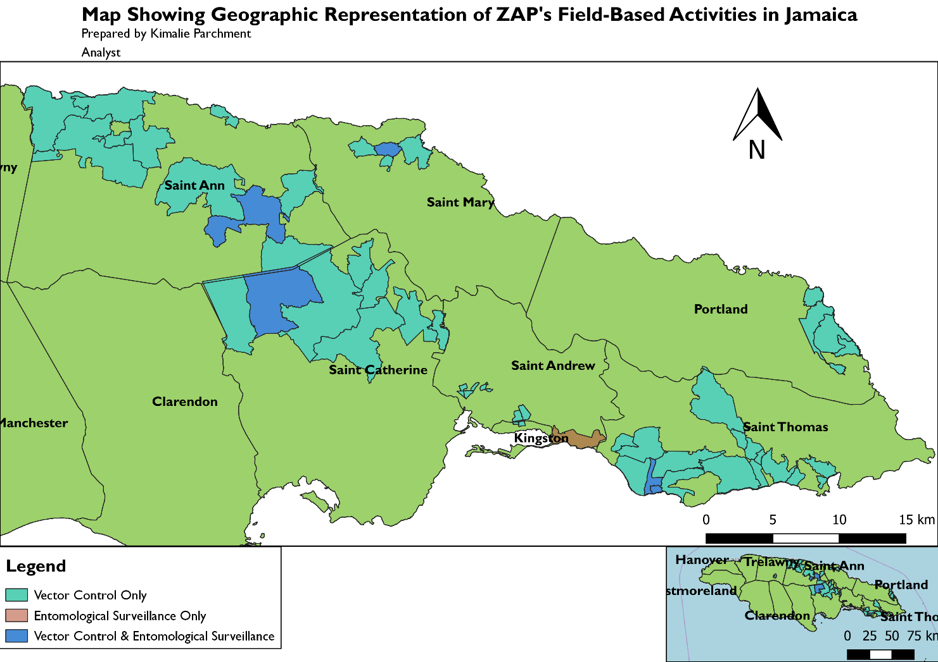
Response to Dengue Outbreak in Jamaica
Response conducted January – April 2019
In late December 2018, the Ministry of Health and Wellness (MOHW) in Jamaica declared a dengue outbreak in the island. ZAP’s support was requested to reduce the vector mosquito populations. The map shows the areas where ZAP operated during January – April 2019.
Conduct vector control surveillance on schedule
Summary of Vector Control Activities
No. of households visits | 236,465
No. of households visits with inspections | 202,047
No. of containers with VC Intervention | 57,224
Amount of Bti applied (g) | 47,187
Average no. of household visits per month | 59,116
Population coverage
Total 292,542
Male 139,505
Female 153,037
Women of Reproductive Age 68,690
Children under 5 19,788

Slide 6
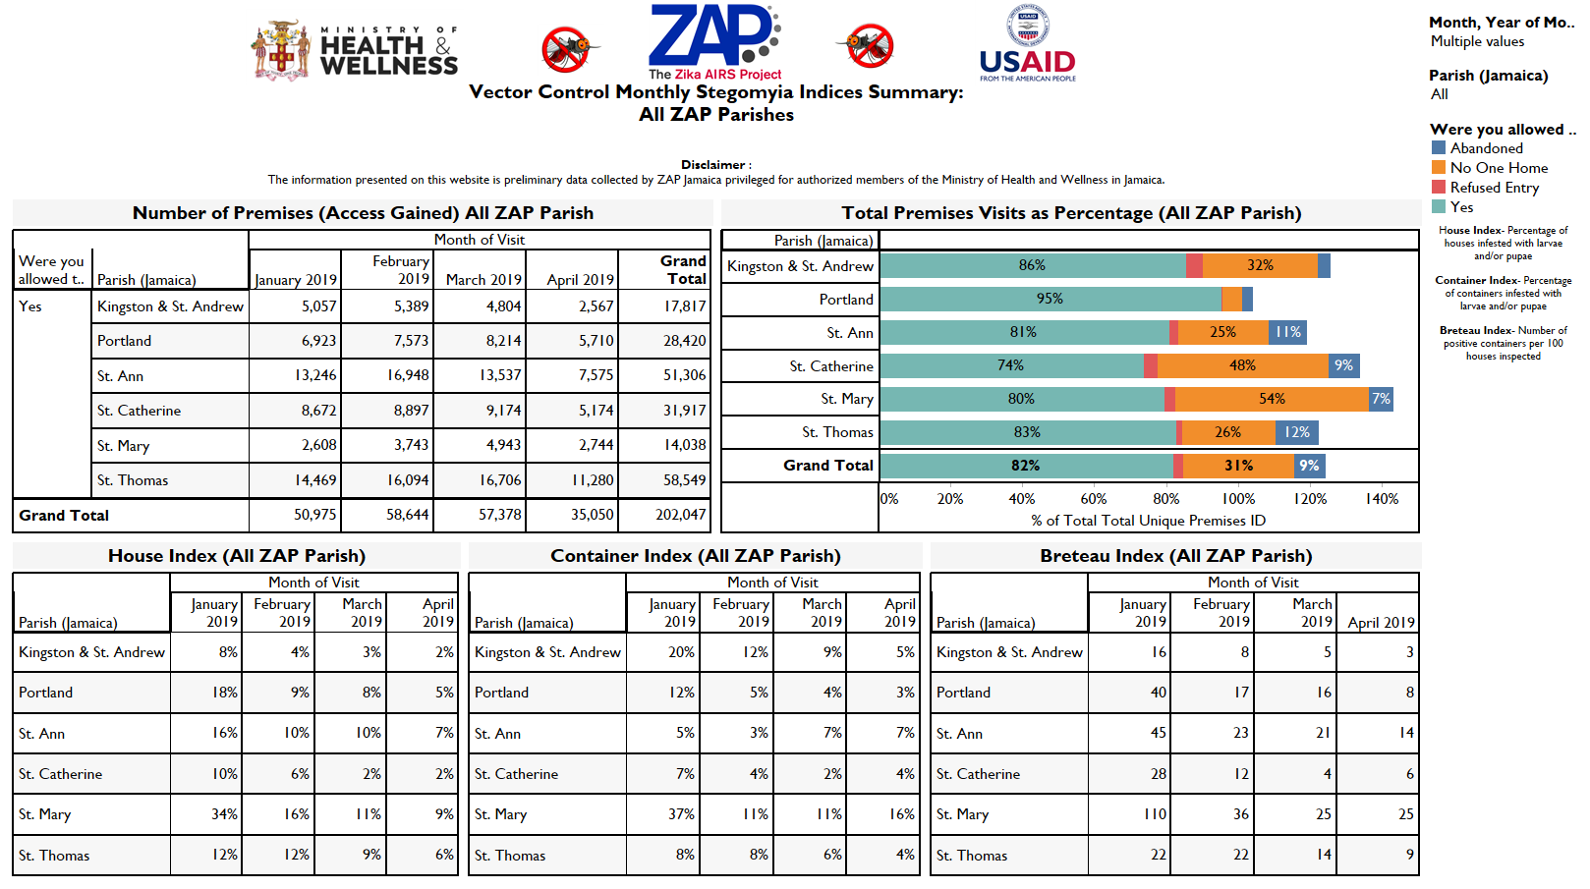
Visual Dashboards
ZAP developed visual dashboards to show key entomological indicators using tables, graphs and maps to drive the decision making process during the outbreak.
The use of GPS enabled us to identify hotspots and also helped to show to effectiveness of various vector control strategies.

Slide 7
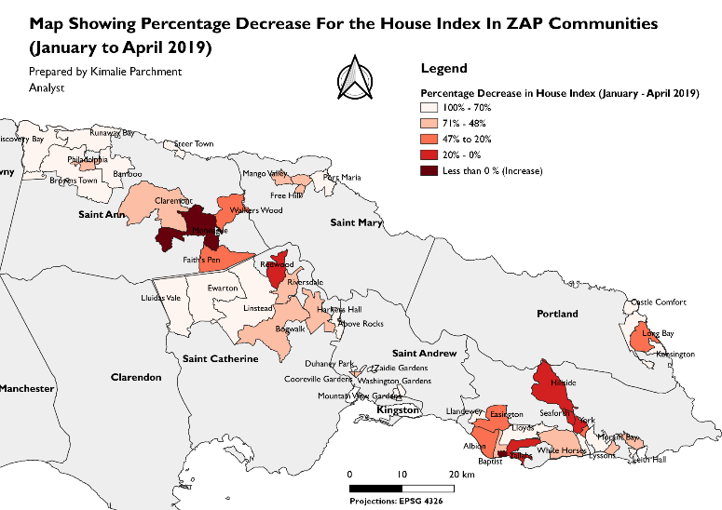
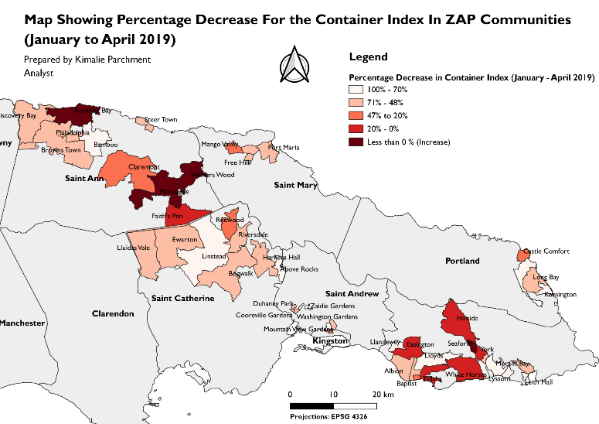
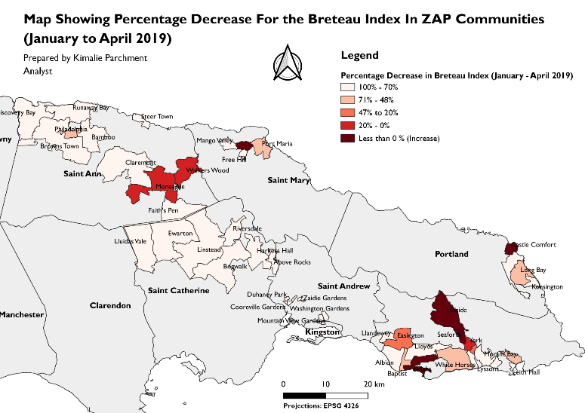
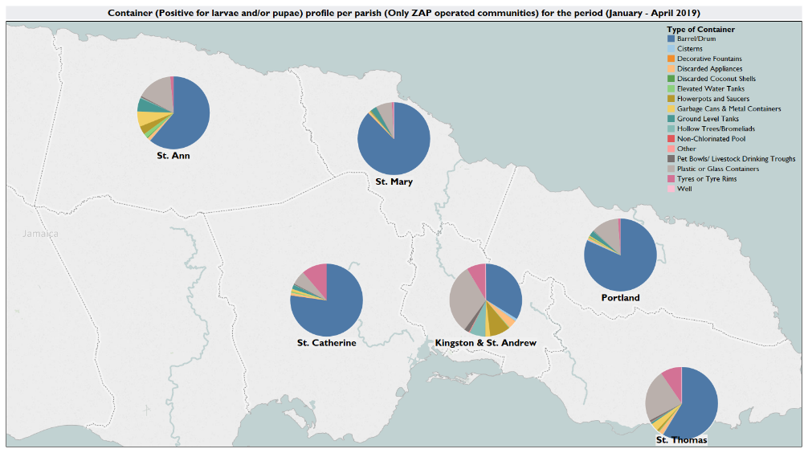
Effectiveness of Vector Control Activities
Maps were used by both ZAP and the MOHW to show improvements and key information as a result of vector control activities
The image below shows preferred breeding site for the Aedes aegypti in most parishes. This can be used to drive decision making such as communication strategies.
Container (Positive for larvae and/or pupae) profile per parish (Only ZAP operated communities) for the period (January - April 2019)
There was a percentage decrease recorded for the three larval indicators for most communities during the period.

Slide 8
Improvements from Real Time Decision Making
USAID Mission
Ministry of Health and Wellness
ZAP team and management
Strategic decisions
Vector Control Manager
Entomological Manager
Identify gaps in strategies and operations.
Field Coordinators
Data Officers
Monitor team performance
Logistic verifications
Resource management
Schedule revisits
Define routes for field operations
Schedule spot check visits
Other internal data quality checks

Slide 9
Conclusions
The use of real time data collection tools shortened the time taken to process vital information with high quality.
High quality electronic data was used for real time monitoring with data analysis, data visualization and spatial analysis to show trends for data driven decision making.
Improvement in the monitoring and evaluation of vector control strategies led to effective preventative measures for wide scale outbreaks of arboviruses.
This system is useful for data-driven decision making as mosquito borne viruses continue to be a public health burden in the region. The Vector Control Unit of the MOHW recently adopted the system, given it is an efficient tool to collect quality data and provides quicker analysis than paper data collection.

Slide 10
Recommendations
For monitoring and evaluation of vector control strategies, the use of electronic data collection and implementation of an information system with real time data will have long term benefits such as Faster, accurate and efficient data to drive the decision making process and cost effective measures for sustainability.

Slide 11
Acknowledgements
USAID for funding and technical support.
Kerri-Ann Guyah (Abt Associates Jamaica) for managing the ZAP field team responsible for all data collection.
ZAP Jamaica staff for the collection of data and all around support.
Special thanks to Dasha Migunov and Carolina Torres Gutierrez for their guidance.

Slide 12
References
Chadee D.D., Huntley S., Focks D.A., Chen A.A. 2009. “Aedes aegypti in Jamaica, West Indies: container productivity profiles to inform control strategies.” Tropical Medicine and International Health. Vol. 14 (2) pp. 220-227
Eisen L, Beaty B.J., Morrison A.C., Scott T.W. 2009. “Proactive Vector Control Strategies and Improved Monitoring and Evaluation Practices for Dengue Prevention.” Journal of Medical Entomology. Vol. 46(6) pp. 1245-1255
Fletcher-Lartey S.M., Caprarelli G. 2016. “Application of GIS technology in public health: successes and challenges.” Cambridge University Press. Vol. 143(4) pp. 401-415

Slide 13
THANK YOU!

